Slide 1
Year 7 – Number line and Place Value. | a) I can order numbers from 0 to 100 using terms such as greater, less than and in between. | I understand place value in integers greater than 100. b) I understand simple decimal notation. b) I can order negative integers. c) I can match simple fractions, decimals and percentages. | d) I can order decimals to two or three places. | e) I can match any terminating decimal to a fraction and a percentage. I can order any numbers including positive and negative integers, fractions, mixed numbers and decimals. | f) I can recognise which fractions are terminating decimals and which are recurring and give reasons why. I can match recurring decimals to fractions.
Notes:
Pupil Version - Print this slide and the next slide two to a page and give to pupils to glue into their books. These should be printed to colour paper so that pupils can easily find them in their books. Pupils should be referring to these in most lessons.

Slide 2
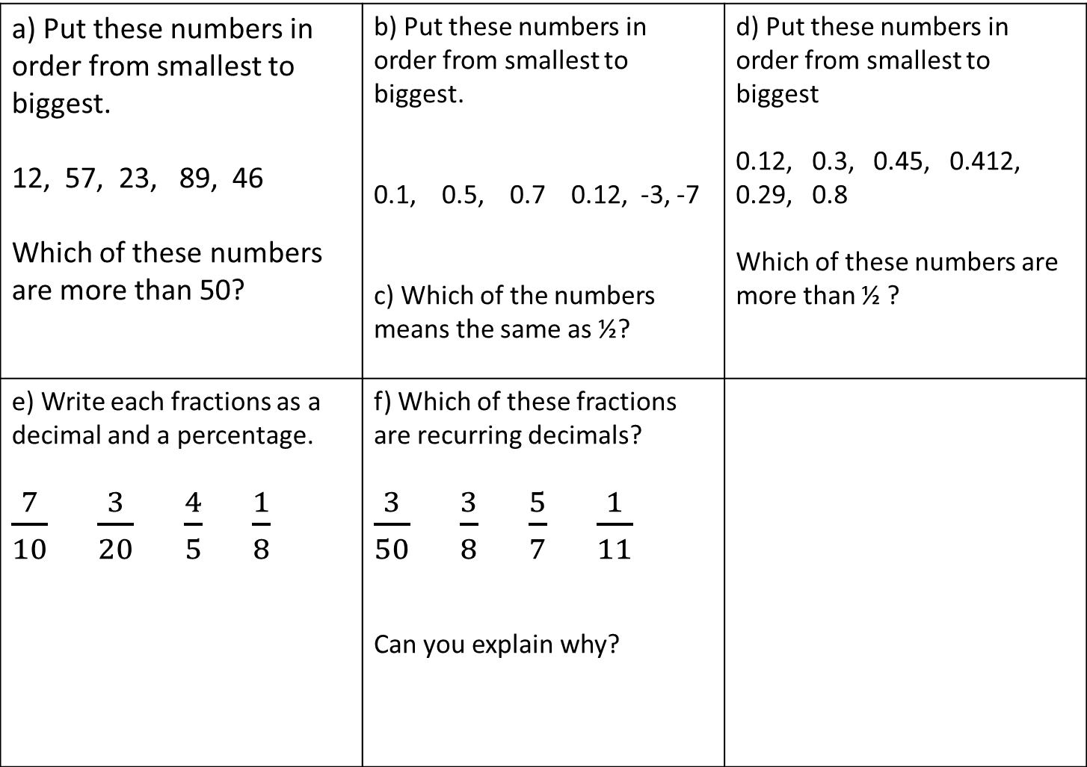
a) Put these numbers in order from smallest to biggest. 12, 57, 23, 89, 46 Which of these numbers are more than 50? | b) Put these numbers in order from smallest to biggest. 0.1, 0.5, 0.7 0.12, -3, -7 c) Which of the numbers means the same as ½? | d) Put these numbers in order from smallest to biggest 0.12, 0.3, 0.45, 0.412, 0.29, 0.8 Which of these numbers are more than ½ ?
e) Write each fractions as a decimal and a percentage. $\frac{7}{10}$ $\frac{3}{20}$ $\frac{4}{5}$ $\frac{1}{8}$ | f) Which of these fractions are recurring decimals? $\frac{3}{50}$ $\frac{3}{8}$ $\frac{5}{7}$ $\frac{1}{11}$ Can you explain why?
Notes:
Print this slide and the previous slide two to a page and give to pupils to glue into their books. These should be printed to colour paper so that pupils can easily find them in their books. Pupils should be referring to these in most lessons.

Slide 3
9
7-8
5-6
3-4
1-2
Year 7 – Autumn 1 Number line and Place Value. | I can order numbers from 0 to 100 using terms such as greater, less than and in between. | I understand place value in integers greater than 100. I understand simple decimal notation. I can order negative integers. I can match simple fractions, decimals and percentages. | I can order decimals to two or three places. | I can match any terminating decimal to a fraction and a percentage. I can order any numbers including positive and negative integers, fractions, mixed numbers and decimals. | I can recognise which fractions are terminating decimals and which are recurring and give reasons why. I can match recurring decimals to fractions.
Notes:
Teacher Version – This version goes on the front of the end of unit assessment task.

