Slide 1
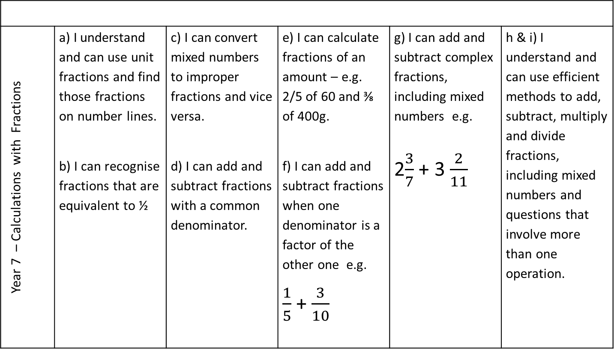
Year 7 – Calculations with Fractions | a) I understand and can use unit fractions and find those fractions on number lines. b) I can recognise fractions that are equivalent to ½ | c) I can convert mixed numbers to improper fractions and vice versa. d) I can add and subtract fractions with a common denominator. | e) I can calculate fractions of an amount – e.g. 2/5 of 60 and ⅜ of 400g. f) I can add and subtract fractions when one denominator is a factor of the other one e.g. $\frac{1}{5}$ + $\frac{3}{10}$ | g) I can add and subtract complex fractions, including mixed numbers e.g. 2$\frac{3}{7}$ + 3 $\frac{2}{11}$ | h & i) I understand and can use efficient methods to add, subtract, multiply and divide fractions, including mixed numbers and questions that involve more than one operation.
Notes:
Pupil Version - Print this slide and the next slide two to a page and give to pupils to glue into their books. These should be printed onto blue paper so that pupils can easily find them in their books. Pupils should be referring to these every lesson.

Slide 2
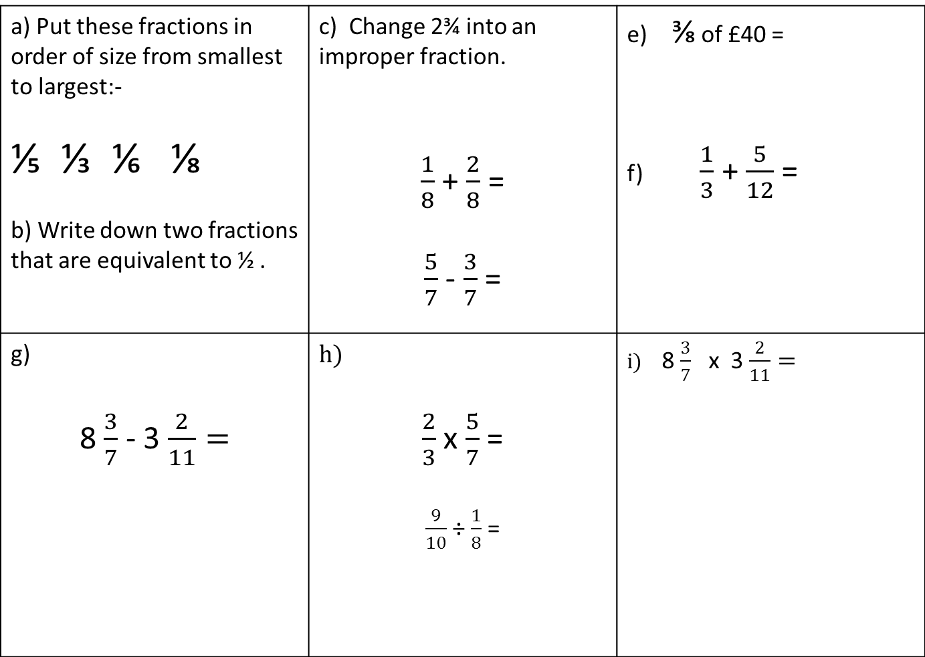
a) Put these fractions in order of size from smallest to largest:- ⅕ ⅓ ⅙ ⅛ b) Write down two fractions that are equivalent to ½ . | c) Change 2¾ into an improper fraction. $\frac{1}{8}$ + $\frac{2}{8}$ = $\frac{5}{7}$ - $\frac{3}{7}$ = | e) ⅜ of £40 = f) $\frac{1}{3}$ + $\frac{5}{12}$ =
g) 8 $\frac{3}{7}$ - 3 $\frac{2}{11}=$ | h) $\frac{2}{3}$ x $\frac{5}{7}$ = $\frac{9}{10}$ ÷ $\frac{1}{8}$ = | i) 8 $\frac{3}{7}$ x 3 $\frac{2}{11}=$
d)

Slide 3
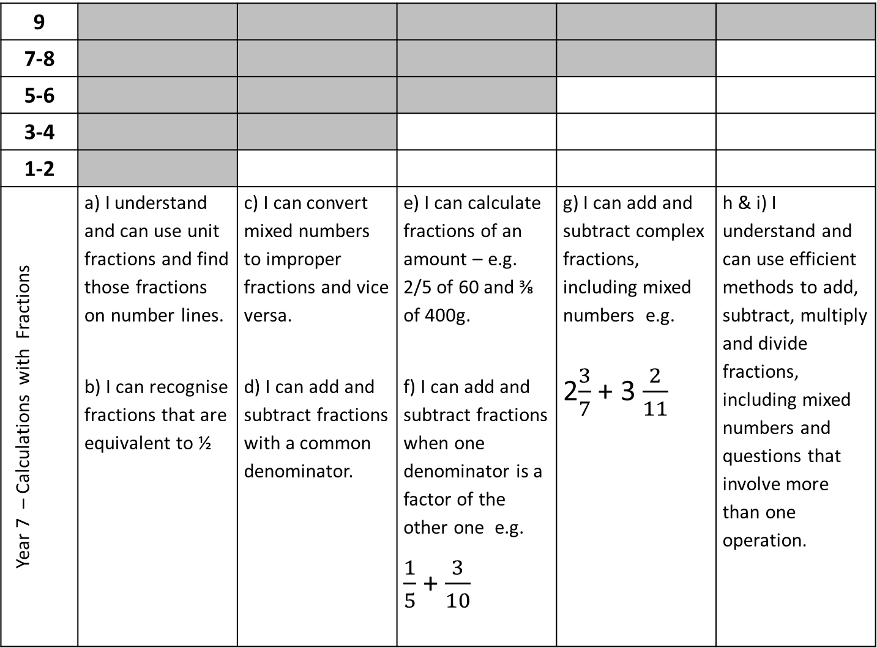
9
7-8
5-6
3-4
1-2
Year 7 – Calculations with Fractions | a) I understand and can use unit fractions and find those fractions on number lines. b) I can recognise fractions that are equivalent to ½ | c) I can convert mixed numbers to improper fractions and vice versa. d) I can add and subtract fractions with a common denominator. | e) I can calculate fractions of an amount – e.g. 2/5 of 60 and ⅜ of 400g. f) I can add and subtract fractions when one denominator is a factor of the other one e.g. $\frac{1}{5}$ + $\frac{3}{10}$ | g) I can add and subtract complex fractions, including mixed numbers e.g. 2$\frac{3}{7}$ + 3 $\frac{2}{11}$ | h & i) I understand and can use efficient methods to add, subtract, multiply and divide fractions, including mixed numbers and questions that involve more than one operation.
Notes:
Teacher Version – This version goes on the front of the end of unit assessment task.

