Slide 1
Today’s Title. | Today’s Date
To Assess my Understanding of Fractions | 24-Jan-16
Copy down the Title and Date and underline them.
To Assess my Understanding of
Fractions
? / 09 / 15
Starter Activity
Complete the ‘Heard the Word Grid.’
Are there any key words that you have learnt or have a better understanding of now than you did at the start of this unit of work?

Slide 2
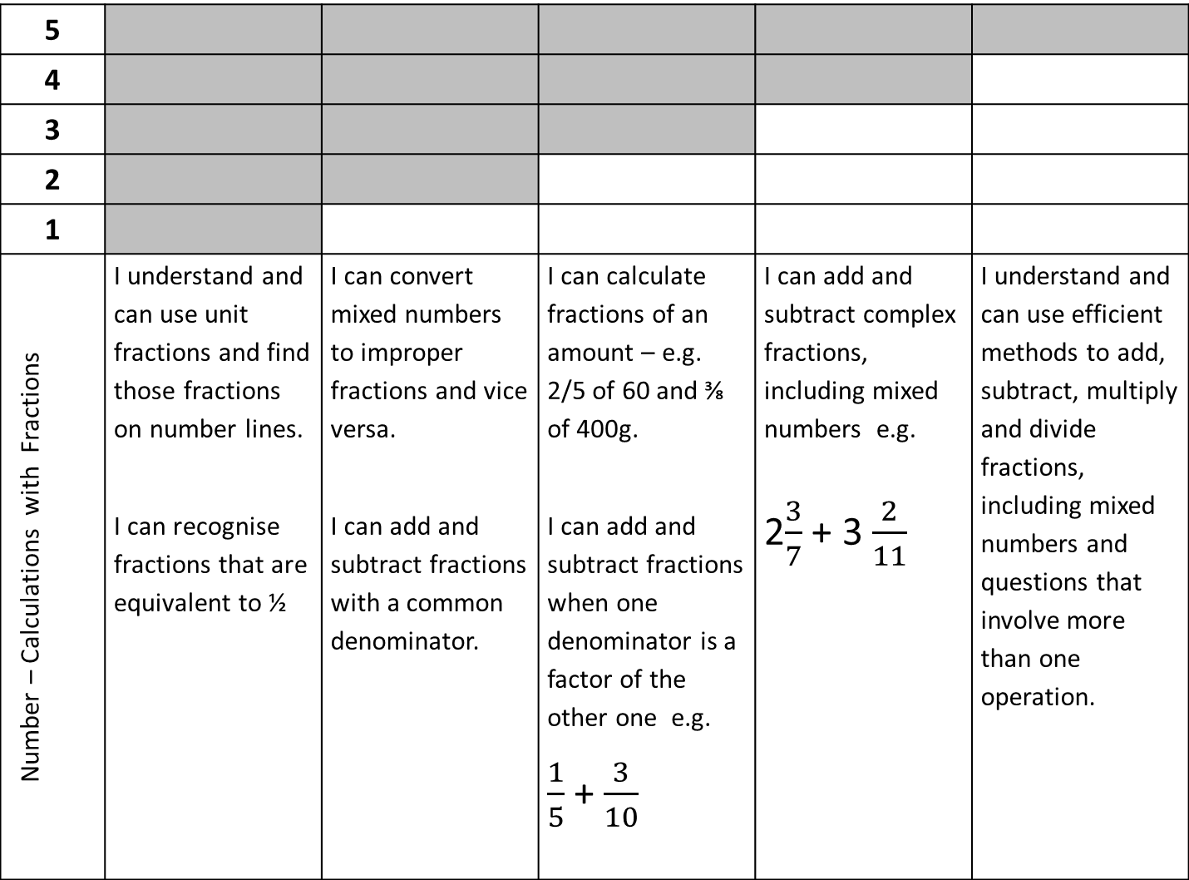
5
4
3
2
1
Number – Calculations with Fractions | I understand and can use unit fractions and find those fractions on number lines. I can recognise fractions that are equivalent to ½ | I can convert mixed numbers to improper fractions and vice versa. I can add and subtract fractions with a common denominator. | I can calculate fractions of an amount – e.g. 2/5 of 60 and ⅜ of 400g. I can add and subtract fractions when one denominator is a factor of the other one e.g. $\frac{1}{5}$ + $\frac{3}{10}$ | I can add and subtract complex fractions, including mixed numbers e.g. 2$\frac{3}{7}$ + 3 $\frac{2}{11}$ | I understand and can use efficient methods to add, subtract, multiply and divide fractions, including mixed numbers and questions that involve more than one operation.

Slide 3
Key Words / Methods | Never heard before? | Heard of but not sure what it means? | Know what it means and can explain it in context Jot down your ideas here...
Numerator
Denominator
Equivalent
Mixed Number
Top Heavy Fraction
Common Denominator
Notes:
Print slides 3-9, two to a page.

Slide 4

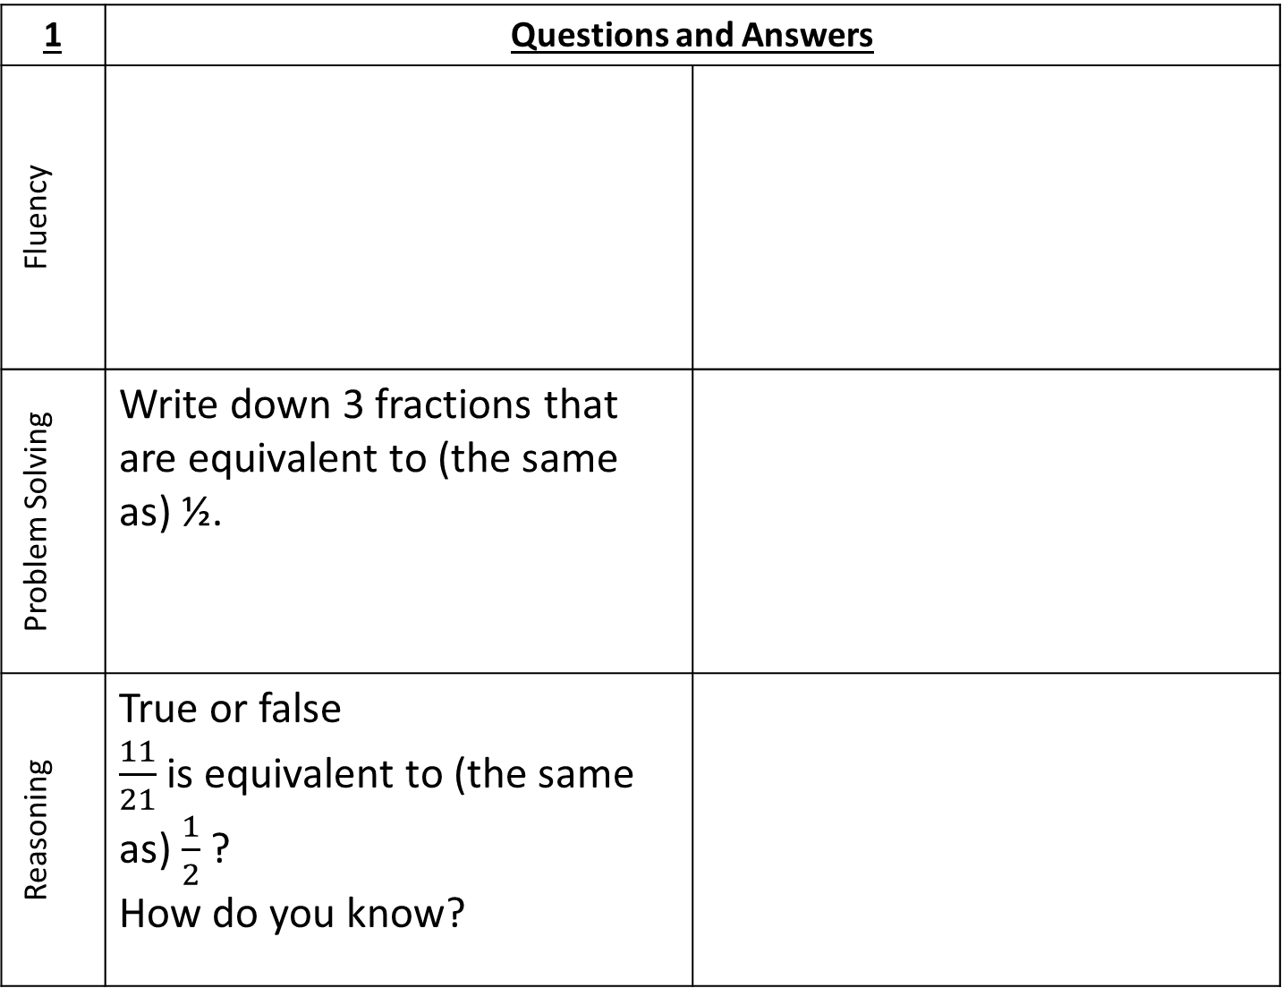
1 | Questions and Answers
Fluency
Problem Solving | Write down 3 fractions that are equivalent to (the same as) ½.
Reasoning | True or false $\frac{11}{21}$ is equivalent to (the same as) $\frac{1}{2}$ ? How do you know?
On the number line opposite mark the following fractions:
$\frac{1}{2}$ $\frac{1}{3}$ $\frac{1}{6}$
0
1

Slide 5
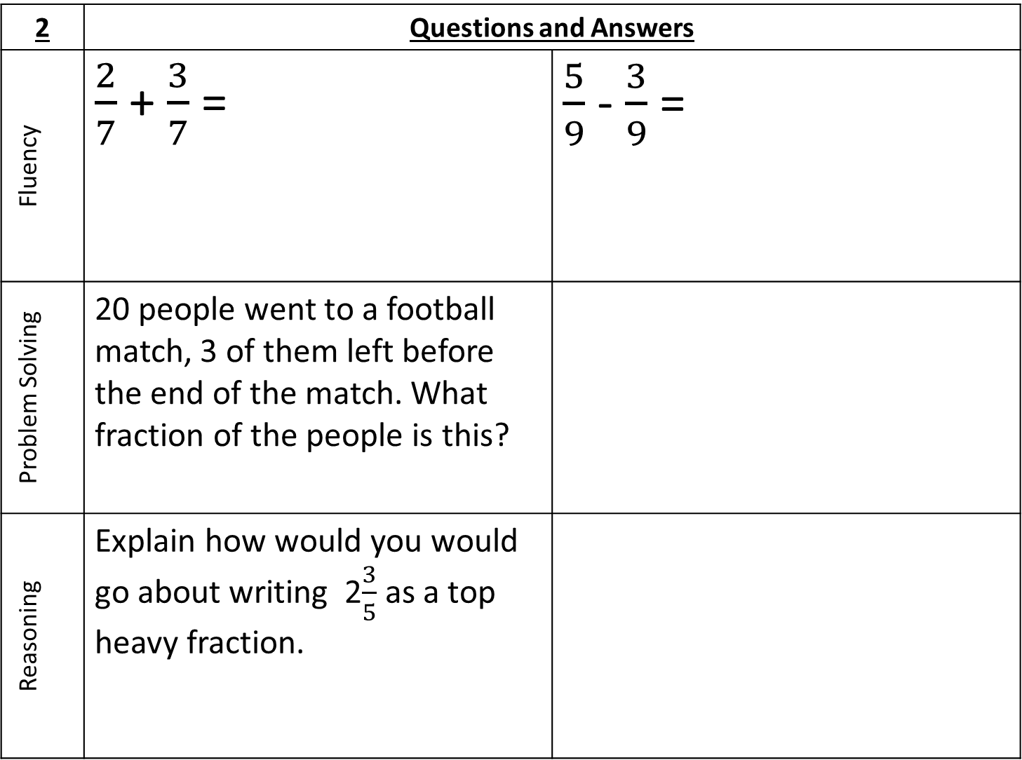
2 | Questions and Answers
Fluency | $\frac{2}{7}$ + $\frac{3}{7}$ = | $\frac{5}{9}$ - $\frac{3}{9}$ =
Problem Solving | 20 people went to a football match, 3 of them left before the end of the match. What fraction of the people is this?
Reasoning | Explain how would you would go about writing 2$\frac{3}{5}$ as a top heavy fraction.

Slide 6
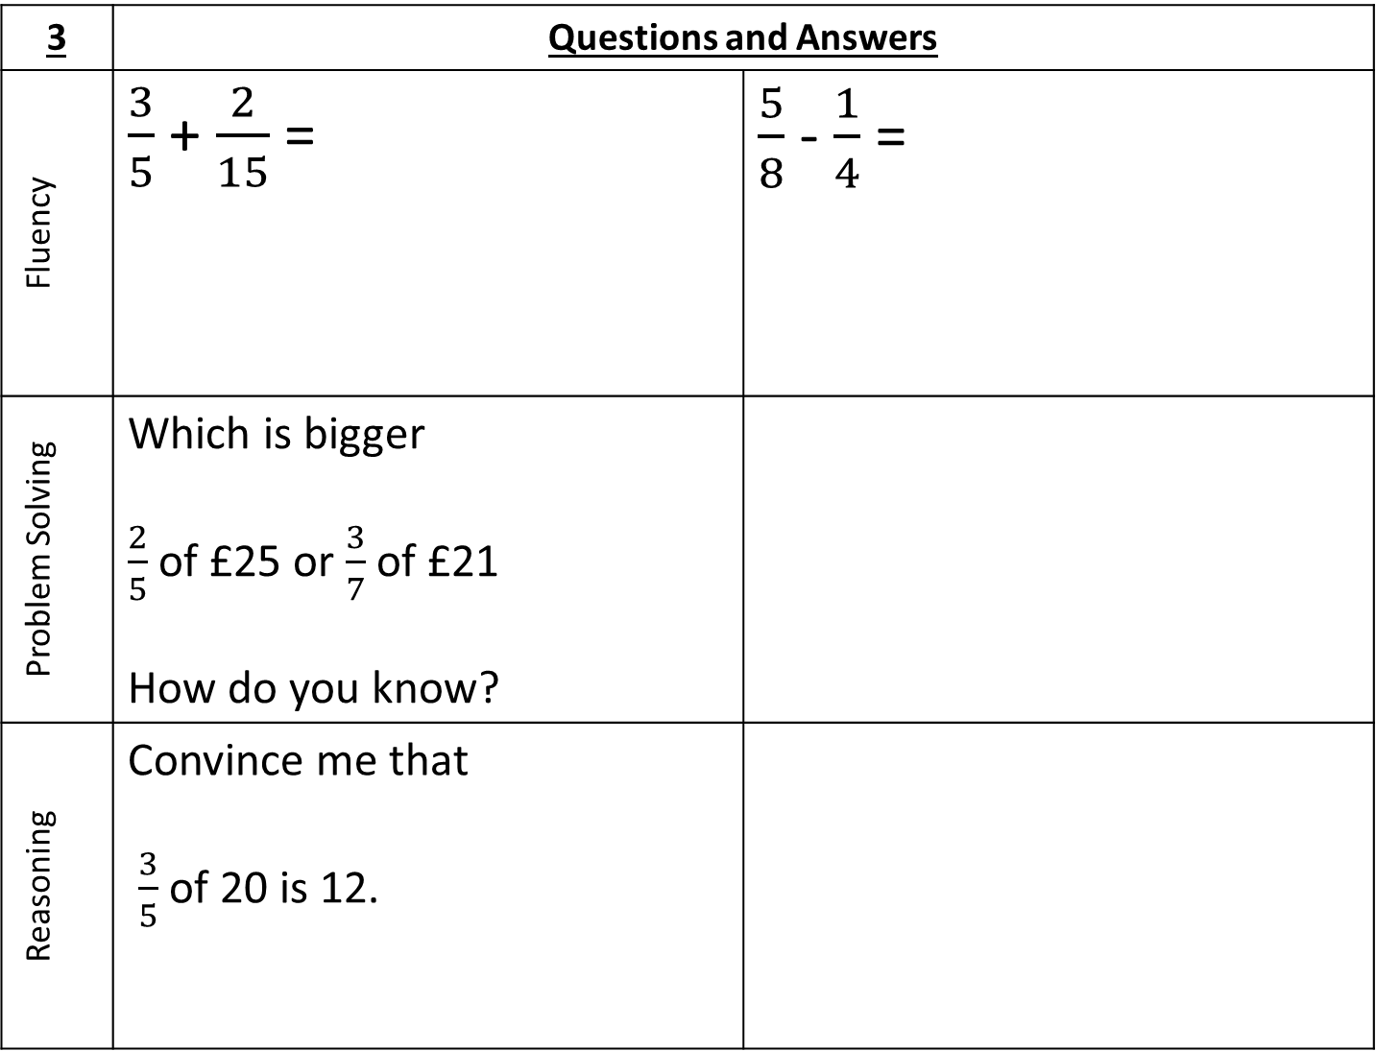
3 | Questions and Answers
Fluency | $\frac{3}{5}$ + $\frac{2}{15}$ = | $\frac{5}{8}$ - $\frac{1}{4}$ =
Problem Solving | Which is bigger $\frac{2}{5}$ of £25 or $\frac{3}{7}$ of £21 How do you know?
Reasoning | Convince me that $\frac{3}{5}$ of 20 is 12.

Slide 7
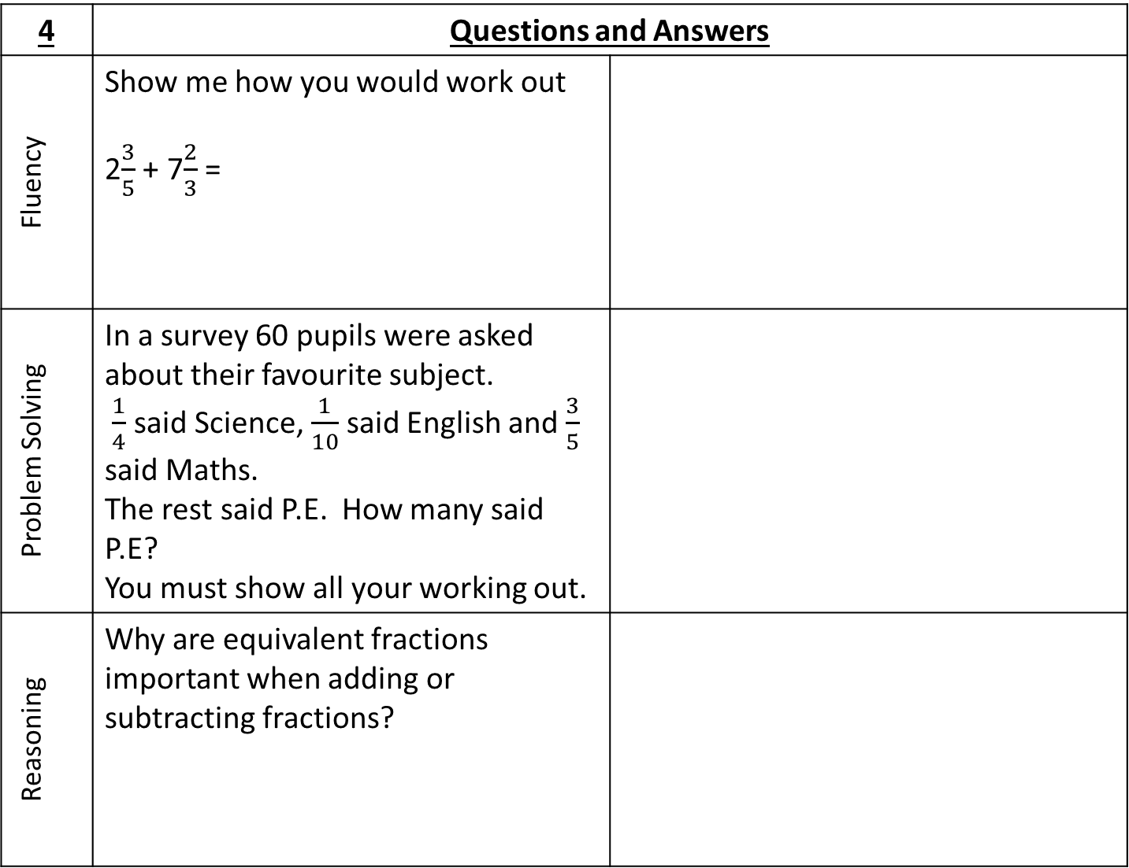
4 | Questions and Answers
Fluency | Show me how you would work out 2$\frac{3}{5}$ + 7$\frac{2}{3}$ =
Problem Solving | In a survey 60 pupils were asked about their favourite subject. $\frac{1}{4}$ said Science, $\frac{1}{10}$ said English and $\frac{3}{5}$ said Maths. The rest said P.E. How many said P.E? You must show all your working out.
Reasoning | Why are equivalent fractions important when adding or subtracting fractions?

Slide 8
5 | Questions and Answers
Fluency | $\frac{3}{5}$ x $\frac{2}{3}$ = | $\frac{4}{7}÷\frac{2}{3}$ =
Problem Solving | Show me two fractions that multiplied together make a whole.
Reasoning | True/Never/Sometimes: ‘Multiplying two fractions together gives a bigger answer than either of the fractions you are multiplying.’

Slide 9
Use the space below to set yourself a question similar to the ones you were able to answer confidently. | Use the space below to answer the question that you have set yourself
My own question… | My answer…
My own question… | My answer…

Slide 10
5
4
3
2
1
Number – Calculations with Fractions | I understand and can use unit fractions and find those fractions on number lines. I can recognise fractions that are equivalent to ½ | I can convert mixed numbers to improper fractions and vice versa. I can add and subtract fractions with a common denominator. | I can calculate fractions of an amount – e.g. 2/5 of 60 and ⅜ of 400g. I can add and subtract fractions when one denominator is a factor of the other one e.g. $\frac{1}{5}$ + $\frac{3}{10}$ | I can add and subtract complex fractions, including mixed numbers e.g. 2$\frac{3}{7}$ + 3 $\frac{2}{11}$ | I understand and can use efficient methods to add, subtract, multiply and divide fractions, including mixed numbers and questions that involve more than one operation.
Notes:
Print this slide and the next slide two to a page and give to pupils to glue into their books. These should be printed onto purple paper so that pupils can easily find them in their books.

Slide 11
My teachers probing question | My answer
What I will do to act upon my ‘Even Better If’’ comment
Strategy | Tick the strategy you will use.
Complete a mymaths lesson or booster pack
Use a revision guide or text book
Ask my teacher to explain during a lesson
Ask a peer to explain during a lesson
Ask someone at home to help
Attend a revision session at school
Attend homework club
Something else (describe your strategy here)
Notes:
Dialogue marking sheet.

