Slide 1
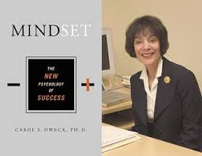
Growth Mindset
Carol S. Dweck: Mindset
‘IQ tests can measure current skills, but nothing can measure someone's potential. It is impossible to tell what people are capable of in the future if they catch fire and apply themselves.’
Notes:
On the screen as colleagues arrive. Explain about question and use of post its to ask questions.

Slide 2
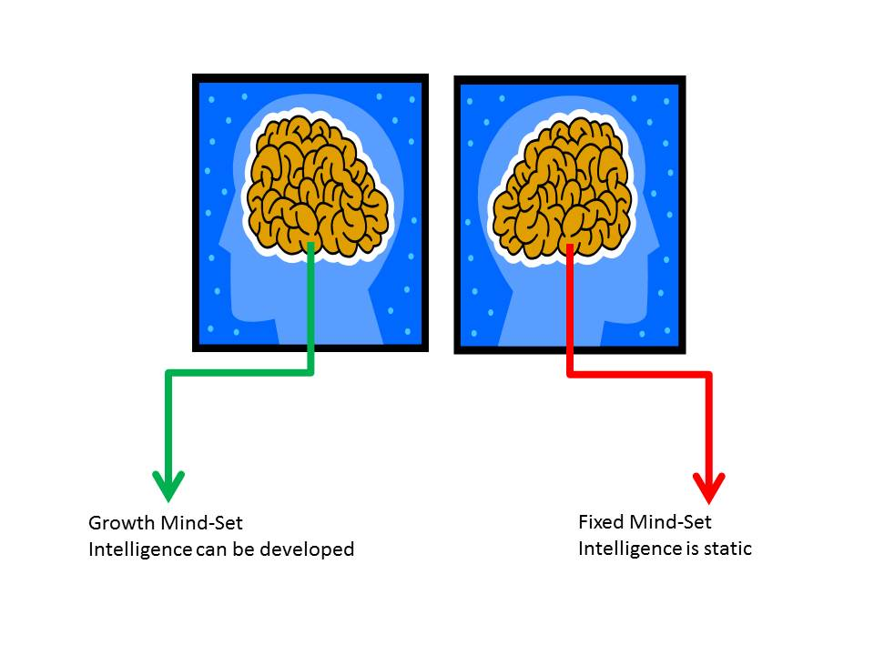
Mindset is often more important than your initial ability in determining whether you succeed in the long run.
Notes:
Brief introduction.

Slide 3
Believe that talents can be developed and great abilities can be built over time. | Are fearful of making mistakes | Think about how they learn
Believe that talent alone creates success | Well behaved pupils | Reluctant to take on challenges
Resilient | Prefer to stay in their comfort zone | View mistakes as an opportunity to develop
Believe that effort creates success | Higher Ability Pupils | Think it is important to ‘look’ smart in front of others
Believe that talents and abilities are set in stone, you either have them or you don’t. | Lower Ability Pupils | Hard Working Pupils
Notes:
Activity 1 Sorting Activity - These statements will be given to groups of 4 on index cards. In groups colleagues will decide where to put each of these statements in the Venn diagram. They will have a blank copy of the Venn diagram to complete as a group.

Slide 4
Growth Mind-set
Fixed Mind-set
Notes:
After each group of 4 has completed their own venn diagram, ask each group to place the index cards on the board using blue tack. Discuss whether all the groups agree, are there any controversial statements.

Slide 5
Growth
Mind-Set
Fixed Mind-Set
Believe that talent alone creates success
Believe that talents can be developed and great abilities can be built over time.
Reluctant to take on challenges
Well behaved pupils
Prefer to stay in their comfort zone
Higher Ability Pupils
View mistakes as an opportunity to develop
Are fearful of making mistakes
Hard Working Pupils
Resilient
Lower Ability Pupils
Think it is important to ‘look’ smart in front of others
Believe that effort creates success
Believe that talents and abilities are set in stone, you either have them or you don’t.
Think about how they learn
Notes:
Answers

Slide 6
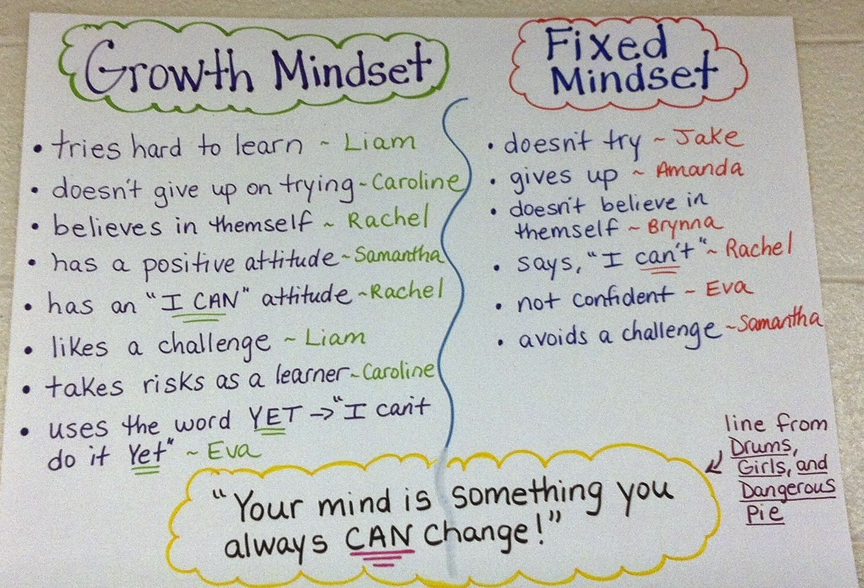
Notes:
Make the point that growth mindset is not about saying that all children can achieve an A* but it is about saying all children have the potential to make greater progress than we thought possible or to make less progress than we expected, and their mindset will play a part in this. Colleagues should think about 7 pupils they teach, 3 fixed, 3 growth, 1 in the middle. Get them to add these students names to the Venn diagrams they used earlier. What statements might these pupils make about themselves.

Slide 7
Statement | Strongly Agree | Agree | Disagree | Strongly Disagree
You are either good at Maths or you aren’t and you can’t change it.
You can only do well in Maths if you are clever.
Your memory affects how good you are in Maths.
Learning new mathematical skills does not mean you are changing your ability.
You can do a lot to change how clever you are.
You can do a lot to change how well you understand mathematics.
If you can answer a question quickly you are good at Maths.
How many answers you get right on a test shows how good you are at Maths.
Practice exercises are the best way to learn new mathematical skills.
Watching a teacher do examples is the best way to learn new mathematical skills.
Trying a problem you don’t know how to solve is the best way to learn new mathematical skills.
The set you are in tells you how good you are at Maths.
I prefer to work on questions that challenge me rather than questions that I find easy.
Notes:
Share with colleagues how they could use the questionnaire to identify growth mindset students. Base data, what does this look like at the end of the year.

Slide 8
Which Mindset do you model in your classroom?
Praising pupils for being smart | Praising effort and strategies
Formative comments that emphasis achievement | Formative comments that emphasis effort and application
Praising students for achievements that come easily | Building robust self confidence
Spending time documenting intelligence and ability | Spending time developing intelligence and ability
Directing pupils to which tasks to complete | Giving pupils a strong voice in the learning process and a sense of purpose
Boosting self esteem | Providing constructive criticism
Place importance on grades / levels rather than learning | Place importance on learning rather than grades / levels
Notes:
Cut out the statements, don’t reveal which are fixed to begin with. Ask colleagues to put them on a continuum, which do they do most frequently.

Slide 9
Which Mindset do you model in your classroom?
Promotes a Fixed Mind Set | Promotes a Growth Mind-Set
Praising pupils for being smart | Praising effort and strategies
Formative comments that emphasis achievement | Formative comments that emphasis effort and application
Praising students for achievements that come easily | Building robust self confidence
Spending time documenting intelligence and ability | Spending time developing intelligence and ability
Directing pupils to which tasks to complete | Giving pupils a strong voice in the learning process and a sense of purpose
Boosting self esteem | Providing constructive criticism
Place importance on grades / levels rather than learning | Place importance on learning rather than grades / levels
Notes:
Share this table with colleagues. Ask colleagues to pick 3 of the strategies which they currently use which promote a fixed mindset, how they could they tweak these to promote a growth mindset? (How can you change your habits.)

Slide 10
Modelling a Growth - Mindset
What growth mindset phrases could you suggest to students to rephrase their fixed mindset phrases?

Slide 11
What fixed mind set pupils might say | What we could encourage them to say
I'm so stupid.
I'm brilliant at this.
I just can’t do Maths, I’ve never been any good at Maths.
This is too hard.
I’m happy with my current grade
You didn’t explain it properly.
What grade / level did I get?
Notes:
Activity 3 Paired task – In pairs colleagues to discuss rephrasing of fixed mindset comments.

Slide 12
Changing your Mindset
If you have a fixed ‘Minsdet’ now, don’t worry, you can change your ‘Mindset.’
Notes:
Explain the importance of making pupils aware that they can change their mindset.

Slide 13
If you hear yourself thinking
I can’t do this…
Notes:
Refer colleagues to the speech bubbles which will be positioned around the room.

Slide 14
Tell yourself
I can’t do this yet…
Notes:
Have these around the room on posters.

Slide 15
If you hear yourself thinking
I’m no good at this…

Slide 16
Tell yourself
I can become better at this…

Slide 17
If you hear yourself asking
What grade did I get?

Slide 18
Ask instead
What can I do to improve…

Slide 19
Progress Pyramid
One question I would like answered…
Two things I am not sure about yet….
Three things I have mastered…
Notes:
Activity 4 Group Task – Give each group a set of these 5 templates to discuss. Do they use anything similar in their classrooms? Are there any that they might consider using?

Slide 20
Colour in the arrow, up to the statement which best describes your current understanding.
 | I’m so confident - I could explain this to someone else!
 | I can get to the right answer but I don’t understand well enough to explain it yet.
 | I understand some of this but I don’t understand all of it yet.
 | I tried hard and I listened but I am finding this challenging. I will make sure that I get help with this next lesson.
 | I do not understand any of this yet. There are things I could do to be a better learner next lesson.

Slide 21
My Favourite MISTAKES
Means
I
Start
To
Acquire
Knowledge
Experience
Skills
A mistake that moved my learning on……

Slide 22

Understanding Self Assessment…………. |  | Understanding Teacher Assessment
I’m confident enough to explain this to someone else. |  | You made excellent progress in today’s lesson.
I understand most of this but not well enough to explain it to someone else yet. |  | You made good progress in today’s lesson.
I’ve really struggled with this, I need help to move my understanding on. |  | You did not make enough progress in today’s lesson.
Effort Self Assessment………. |  | Understanding Teacher Assessment………….
1. I have put a lot of effort into my learning today. | 1. | You demonstrated excellent determination and resilience. You made an effort to show your working out.
2. I have put some effort into my learning today but I know I could have pushed myself further. | 2. | You demonstrated good determination and resilience. You made some effort to show your working out.
3. I was not a good learner in today’s lesson. I can do better. | 3. | You gave up too quickly.

Slide 23
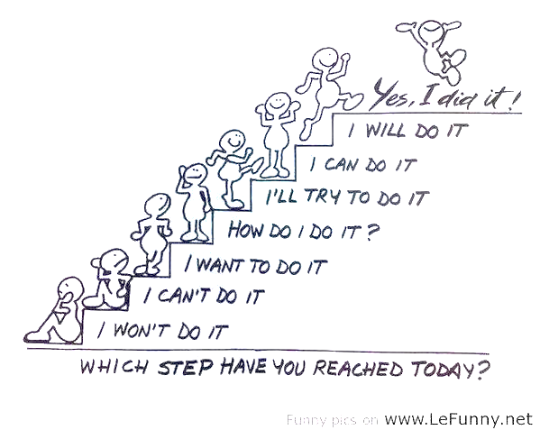
Colour in the person that represents your mindset in today’s lesson.

Slide 24
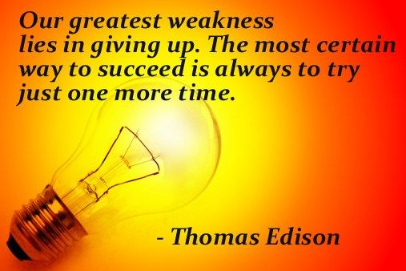
Notes:
Have these posters on the tables as people arrive. What do you believe in, what don’t you believe in, do these resonate with you? (Expand this into a full task, or disappear the task depending on time.)

Slide 25
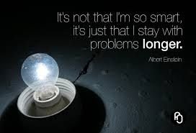

Slide 26


Slide 27
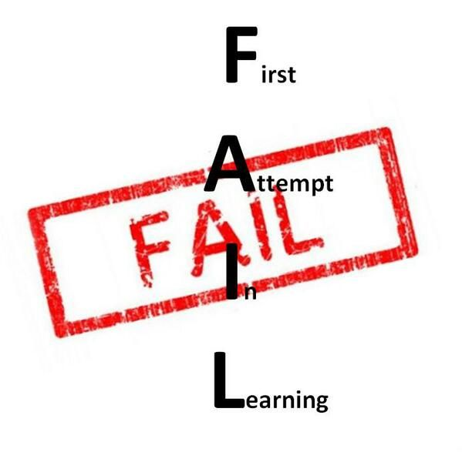

Slide 28
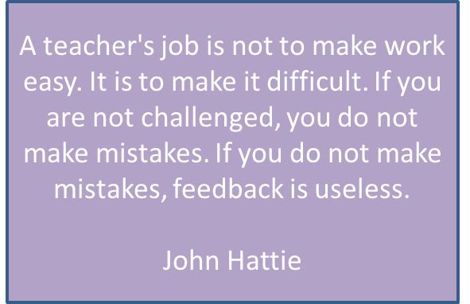

Slide 29
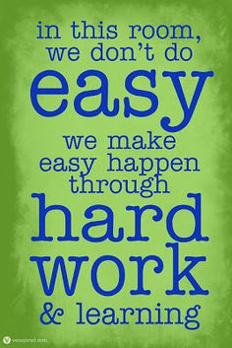
Notes:
Discuss the importance of changing the culture of learning with reference to PACA

Slide 30


Slide 31
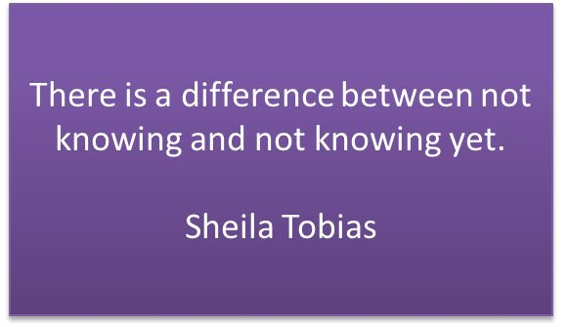

Slide 32
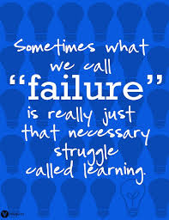

Slide 33
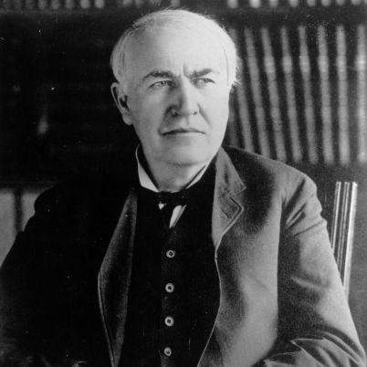
‘You must learn to fail intelligently. Failing is one of the greatest arts in the world. One fails forward towards success.’
Thomas Edison
Notes:
Explain that growth mindset is much more than a ‘can do’ attitude, it is about what pupils do when faced with what they perceive to be failure.

Slide 34
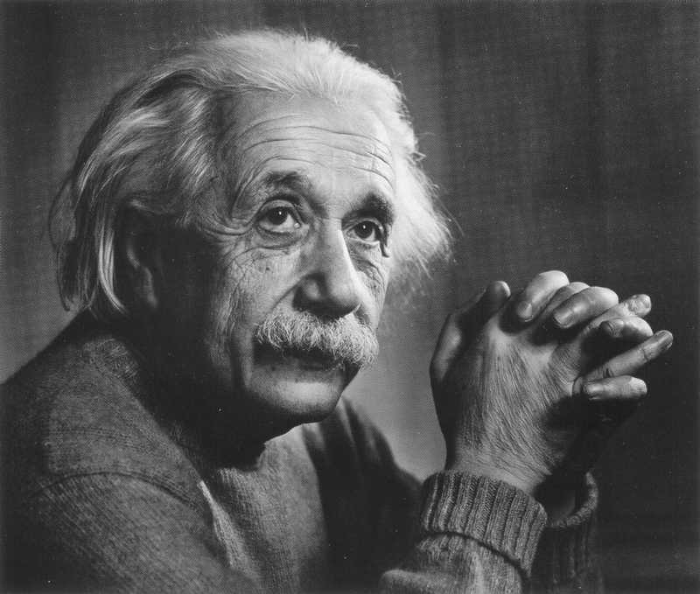
‘I think and think for months and years. Ninety nine times out of a hundred I am wrong. The hundredth time I am right.’
Albert Einstein

Slide 35
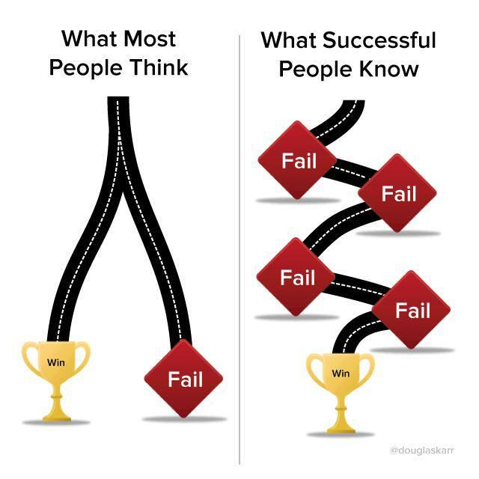

Slide 36
% of students who have gone up at least two entire grades since the module exam in year 10
15%
Notes:
How we celebrated progress in assemblies rather than grades.

Slide 37
These students are:-
Danielle | Up 2
Ellis | Up 2
Ellie | Up 2
Sam | Up 3
Chloe | Up 3
William | Up 3
Joe | Up 3
Briony | Up 3
Laurence | Up 4
Ryan | Up 4
Alexandra | Up 4
George | Up 4
Joe | Up 4
Thomas | Up 4
Joella | Up 4
Ryan | Up 4
Crystal | Up 4
Anna | Up 4
Ashleigh | Up 4
Connor | Up 4
Thomas | Up 4
Dan | Up 5
Holly | Up 5
Emily | Up 5
Notes:
How we celebrating progress in assemblies rather than grades.

Slide 38

Success Stories – Who is this?????
Target Grade D
Year 10
ATL 3
Unit 2 exam result U
Projected grade E
Year 11
ATL 6
November Exam C
Projected Grade B
Interventions: Cookie Club, Maths Camp, ½ Term Revision,
Notes:
How we celebrating progress in assemblies rather than grades.

Slide 39
'Meaningful learning tasks give students a clear sense of progress leading to mastery.
This means that students can see themselves doing tasks they couldn't do before and understanding concepts they couldn't understand before.
Work that gives students a sense of improvement as a result of effort gives teachers an opportunity to praise students for their process.
That is, teachers can point out that the students' efforts were what led to the progress and improvement over time.'
(Dweck 2010)
Notes:
Discuss the importance of sharing progress with students in addition to sharing attainment.

Slide 40

Sharing Strategies
How do you make progress visible to your students?
Write your strategy on the
post it note provided and add
it to the board.
Notes:
Activity 5 – Provide post it notes, whole group discussion.

Slide 41
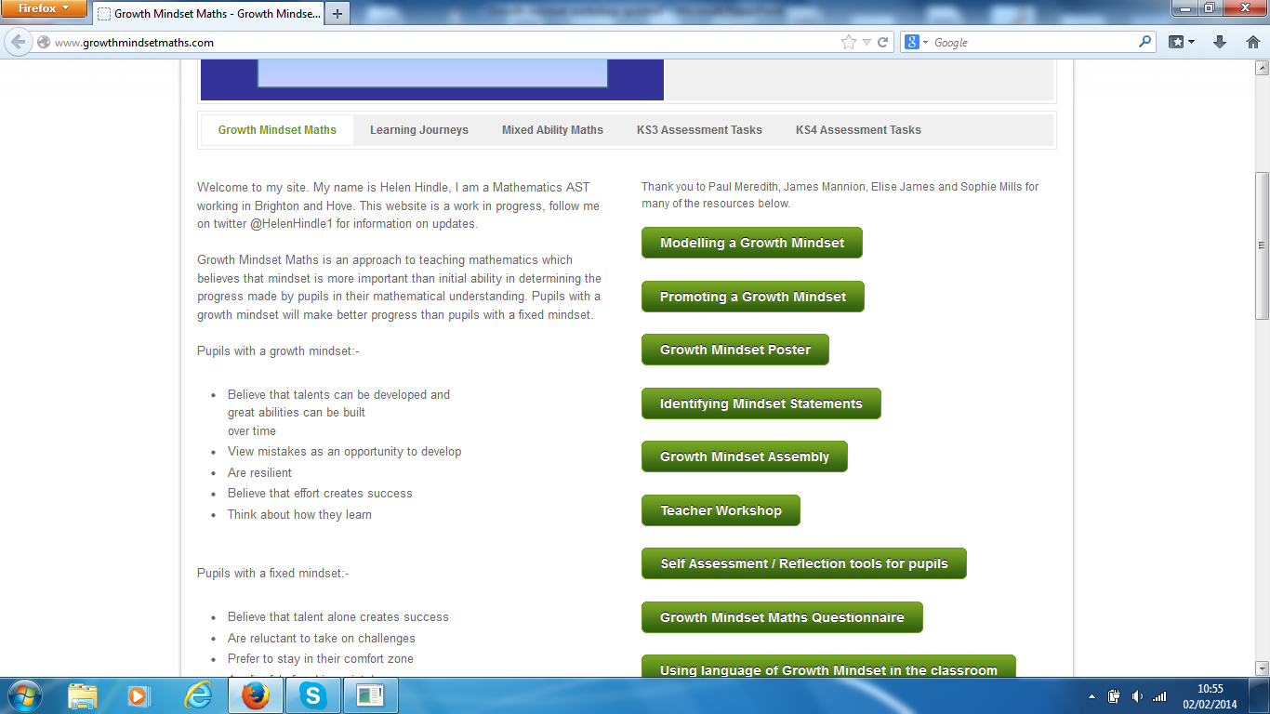
Notes:
Share Website

Slide 42


