Slide 1
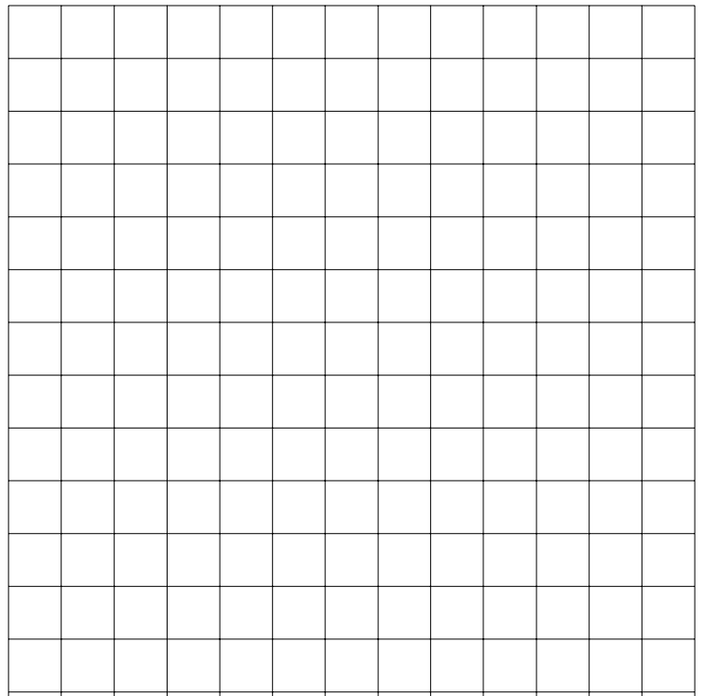
Today’s Learning Objective /Title | Today’s Date
To learn through Inquiry | 27-Sep-15
Copy down the Learning Objective and the Date and underline them.
? / 09 / 15
To Learn Through Inquiry

Slide 2
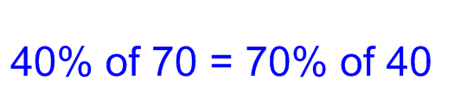
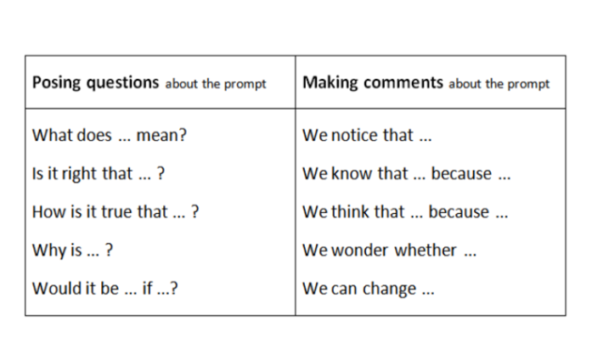
Ask a question or make a comment about the prompt.
You can use the sentence starters below to help you.
Notes:
Pupil hand-out.

Slide 3
Notes:
Use this slide to record the questions and comments suggested by the class. Make sure that each pair is given the opportunity to contribute.

Slide 4
Choose a regulatory card or cards to decide what you are going to do next.
You can refer to all of these cards throughout the Inquiry when you are not sure what to do next.
Notes:
Ask pairs of students to share which of the card / cards they chose and the reasons why. As this is their first Inquiry of year 7 the regulatory cards have been limited to 6.

Slide 5
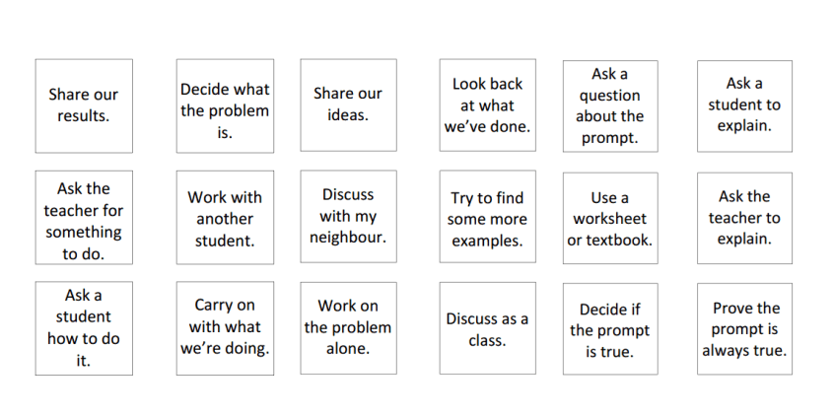
Notes:
Alternative set of regulatory cards.

Slide 6
Alternative Prompts
10% of 50 = 50% of 10
40% of 70 = 70% of 40
47% of 74 = 74% of 47
20% of 30% of 40 = 40% of 30% of 20
Notes:
The prompt can be changed in the following ways to provide enough intrigue at each level:

Slide 7
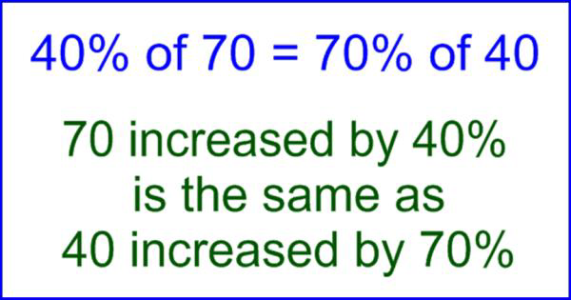
Notes:
The prompt can be made more complex by presenting it alongside a second statement. The second part of the statement here is not true. Students have raised the question, ‘Can it ever be true for two increases if the number and percentage are different?’ and gone on to conclude that it cannot.

Slide 8
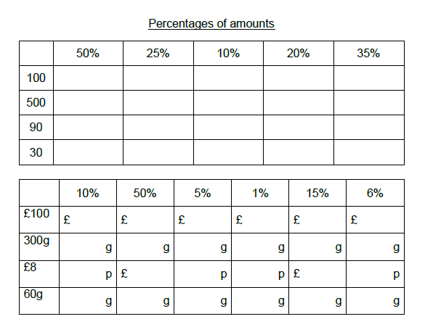
Task A - Percentages of An Amount
Notes:
Pupil handout - This task can be used as an easier task for pupils that ask the teacher for something to do.

Slide 9
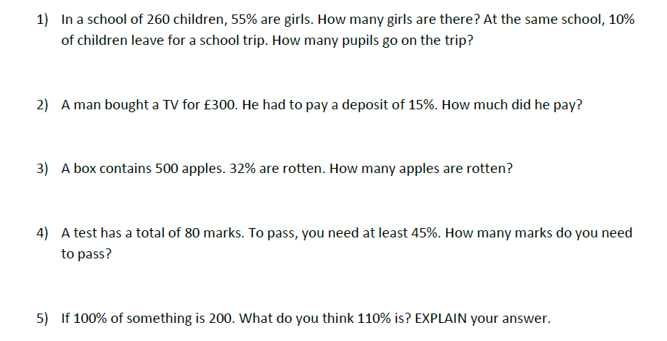
Task B - Worded Questions
Notes:
Pupil handout - This task can be used as a harder task for pupils that ask the teacher for something to do.

Slide 10
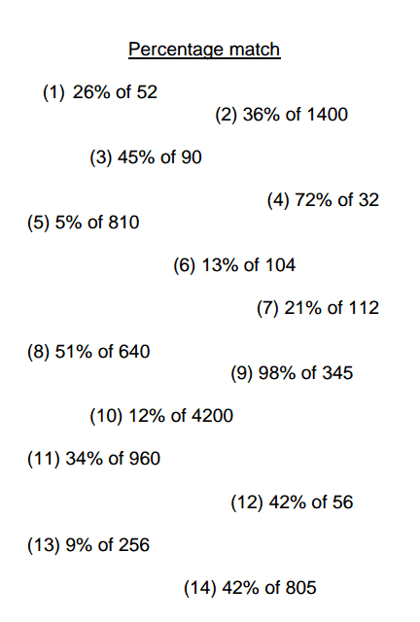
Task C - Percentages Match
Write the pairs in your book and explain how they are connected.
(2) Make up three more pairs of your own.
Notes:
Pupil handout - This task can be used as a harder task for pupils that ask the teacher for something to do.

Slide 11
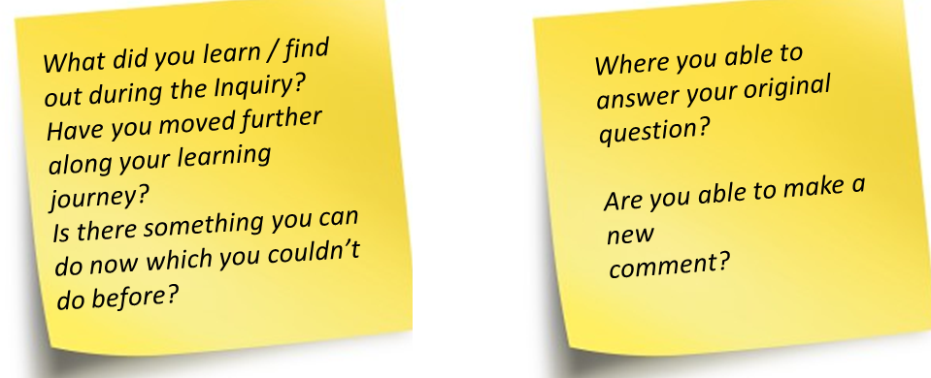

Percentages Inquiry - Reflecting and Evaluating
My original comment / question about the prompt …
Examples
Discoveries / Explanations / Conclusions
Questions still to investigate ………
What would you like to explore / find out about next?
You can use the Sentence Starters if it helps.
Sentence Starters
I’m wondering ……I’m thinking ………..I would like to know….What if ………..My next steps are to …..
Notes:
Use this slide to explain to pupils how to use the template to present their results.

Slide 12
Number Line Inquiry - Reflecting and Evaluating
My original comment / question about the prompt
Examples
Discoveries / Explanations / Conclusions
Questions still to investigate ………
Notes:
Pupil hand out. Print to A3 for pupils to complete.

