Slide 1
Mixed Ability Teaching
Why?
What?
How?

Slide 2
Made to Measure Report 22nd May 2012
Children’s varying pre-school experiences of mathematics mean they start school with different levels of knowledge of number and shape.
For too many pupils, this gap is never overcome: their attainment at 16 years can largely be predicted by their attainment at age 11, and this can be tracked back to the knowledge and skills they have acquired by age 7.
Low attainment too often becomes a self-fulfilling prophecy. Pupils known to be eligible for free school meals fare particularly badly.

Slide 3
Overall, ability grouping appears to benefit higher attaining pupils and be detrimental to the learning of mid-range and lower attaining learners. On average, ability grouping does not appear to be an effective strategy for raising the attainment of disadvantaged pupils, who are more likely to be assigned in lower attaining groups. Summer born pupils and students from ethnic minority backgrounds are also likely to be adversely affected by ability grouping.
Low attaining learners fall behind by one or two months a year, on average, when compared with the progress of similar students in classes without ability grouping.
It appears likely that routine setting or streaming arrangements undermine low attainers’ confidence and discourage the belief that attainment can be improved through effort. Research also suggests that ability grouping can have a longer term negative effect on the attitudes and engagement of low attaining pupils.

Slide 4
What is mixed ability teaching
Ensuring that classes are balanced with a range of:-
Prior attainment,
SEN,
FSM
Attitude to Learning

Slide 5
Making Mixed Ability Teaching Successful:-
Students must be given ownership of their own learning,
'Meaningful learning tasks give students a clear sense of progress leading to mastery. This means that students can see themselves doing tasks they couldn't do before and understanding concepts they couldn't understand before. Work that gives students a sense of improvement as a result of effort gives teachers an opportunity to praise students for their process. That is, teachers can point out that the students' efforts were what led to the progress and improvement over time.'
(Dweck 2010)

Slide 6
Using Learning Journeys
Learning Journeys were developed as a strategy to foster a 'clear sense of progress', among our students.
Learning Journeys
Give pupils a sense of purpose
Give pupils a strong voice in the learning process
Take pupils out of their comfort zone
Encourage pupils to challenge themselves
Make progress visible to students and place an emphasis on progress rather than attainment
Indicate to students what skills they need to work on in the future.

Slide 7
Level | 3 | 4 | 5 | 6
Angles | I can identify right angles | I can recognise, measure and draw acute and obtuse angles I know that the sum of the angles on a line is 180º and the sum of the angles at a point is 360º | I know the sum of the interior angles of a triangle and a quadrilateral. I can calculate missing angles in triangles and quadrilaterals I can recognise, measure and draw reflex angles | I can calculate the size of an interior and exterior angles in a regular polygon. I can calculate missing interior angles and exterior angles in irregular polygons. I can identify alternate and corresponding angles and calculate missing angles on parallel lines.
I am starting the lesson on level _____________________
By the end of this lesson I want to be able to _____________________

Slide 8
All pupils must have access to the full range of differentiated tasks
Pupils must be given the opportunity to select the appropriate task for themselves
Pupils should be aware that every lesson they should be engaged in a task which challenges them but which is also achievable
Pupils should be given frequent opportunities to reflect on their learning / progress

Slide 9
‘Teaching math through problem solving or inquiry needs a math-talk rich community of learners. A community of learners that is at ease with asking clarifying questions, advancing personal conjectures and awaiting feedback from peers.’
@paul_aniceto
https://chalkboardinquiries.wordpress.com/2014/04/26/math-talk-community-its-more-than-just-talk-its-about-addressing-status-and-curbing-the-fixed-mindset/

Slide 10
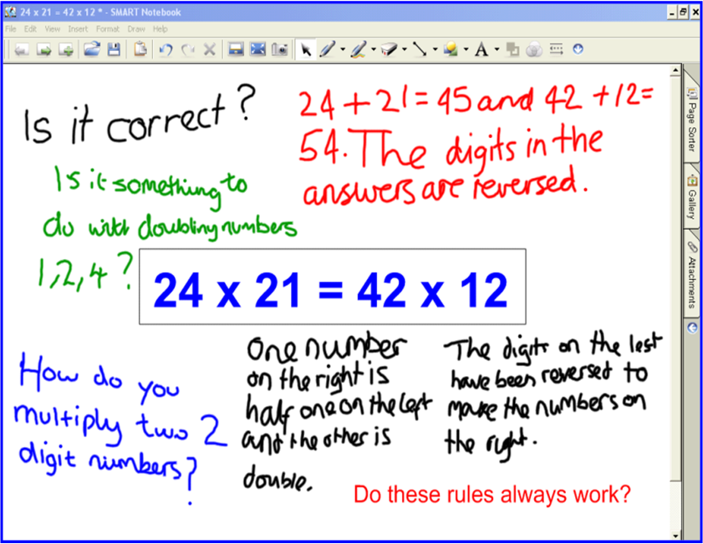
Rationale for Inquiry
Students learn to
Ask questions
Make conjectures
Plan and monitor their activity
Explore ideas in collaboration
Identify when they need new knowledge
Ask the teacher for instruction
Explain their reasoning
Prove their results
Andrew Blair www.inquirymaths.com
@inquirymaths

Slide 11
Low Threshold High Ceiling Tasks
Where the task has a ‘ceiling’ the ceiling must be beyond what any pupil would be able to achieve independently
Where a task has a low threshold pupils must be able to ‘enter’ the task at a level within their Zone of Proximal Development

Slide 12
Pupils should be encouraged to work collaboratively with their peers
Seating plans should not position pupils in within class ability groups

Slide 13
Pupils understanding that the ‘best’ pupils are those that make the most progress, not necessarily those with the highest levels / grades.
We will see....
We believe....
‘The Aim – Promoting a growth mindset through mixed ability teaching.’
Students recognising the importance and functionality of Maths.
Pupils taking responsibility for their own actions and their own learning.
Pupils asking questions.
In depth discussions about the Maths.
Pupils have the power to surprise us and themselves about what they can achieve.
Pupils helping each other and actively involved in the learning process.
Pupils should have high aspirations.
Pupils learning through Inquiry.
Formative assessment and feedback enables progression.
Pupils can learn from one another.
Pupils making suggestions about their learning.
Less reliance on the teacher, more independent learning.
All pupils have potential.
Grouping by ability can limit the learning experiences of our pupils.
Pupils aware of how to progress.
Resilience.
Engagement.
Pupils need to ‘see’ progress.
Good teacher / pupil relationships.
Enthusiasm.
Empowering pupils to make decisions about how much challenge they can attempt helps them to make progress.

Slide 14
Mixed ability teaching = consistently good teaching
Differentiation
Range of types of activity
Student led

Slide 15
Setting high expectations is the single most important thing you can do to ensure good progress in learning, Make sure specific groups of students are aware of what they need to do to make progress…
Challenge
Collaboration
Choice

