Slide 1
LO To assess my understanding of place value.
RAG
Key Words: Reflect, Communicate, Explain, Justify
21-Jul-15
Starter Activity
Complete the ‘Heard the Word Grid.’
Are there any key words or symbols that you have learnt or have a better understanding of now than you did at the start of this unit of work?
Notes:
1

Slide 2
Key Words / symbols | Never heard before? | Heard of but not sure what it means? | Know what it means and can explain it in context Jot down your ideas here...
Integer
<
>
=
≠
Numerator
Denominator
Equivalent

Slide 3
Flight Path | 5
 | 4
 | 3
 | 2
 | 1
Year 7 Autumn 1 Number line – Place Value |  | I can order numbers to 100 using terms such as greater, less than and in between. | I understand simple decimal notation. | I can order decimals to two or three places. | I can match terminating decimals to fractions. | I can recognise which fractions are terminating decimals and which are recurring and give reasons why.

Slide 4
Flight Path 1 Fluency (Closed) | Place these numbers in order from smallest to biggest using the number line below 23, 91, 34, 17, 56, 88.
Flight Path 1 Problem Solving (Open) | Holly made a number using these digit cards. The hundreds digit is greater than 4 Holly’s number is odd. What is the biggest number that Holly could have made?
Flight Path 1 Reasoning (Probing) | Tom says that any number with 9 tens is going to be bigger than any number with 6 tens. Is Tom right? Explain your answer.
0
10
20
30
40
50
60
70
80
90
100
5 | 6 | 8 | 6

Slide 5
Flight Path 2 Fluency (Closed) | Place these numbers in order from smallest to biggest using the number line below:- 0.3 0.9 0.7 0.25
Flight Path 2 Problem Solving (Open) | Here are 3 digit cards and a decimal point. How many 2 digit numbers that are less than 3 is it possible to make using these cards? You can use each card more than once.
Flight Path 2 Reasoning (Probing) | Emma says that 3.60 is more than 3.6 Is Emma correct? Explain your answer.
0
0.5
1
1 | 2 | 3 | .

Slide 6
Flight Path 3 Fluency (Closed) | Put these decimals in order from largest to smallest: 6.615, 6.67, 6.111, 6.606, 6.06
Flight Path 3 Problem Solving (Open) | Last year, Bill weighed 85.7 kg. This year Bill weighs 85.12kg. Describe how Bill’s weight has changed.
Flight Path 3 Reasoning (Probing) | Convince me that 0.36 is greater than 0.351

Slide 7
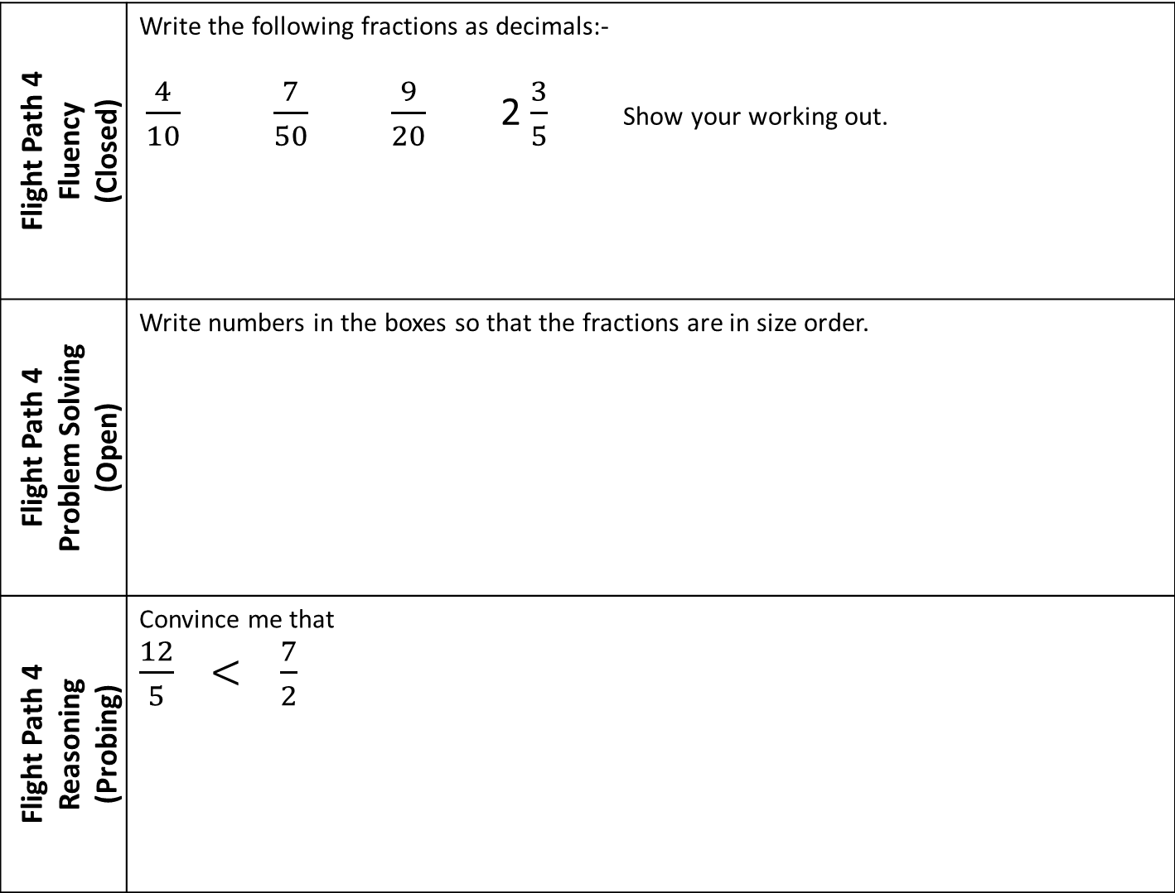
Flight Path 4 Fluency (Closed) | Write the following fractions as decimals:- $\frac{4}{10}$ $\frac{7}{50}$ $\frac{9}{20}$ 2 $\frac{3}{5}$ Show your working out.
Flight Path 4 Problem Solving (Open) | Write numbers in the boxes so that the fractions are in size order.
Flight Path 4 Reasoning (Probing) | Convince me that $\frac{12}{5}$ $< \frac{7}{2}$

Slide 8
Flight Path 5 Fluency (Closed) | Circle any fractions that are recurring decimals $\frac{3}{5}$ $\frac{3}{11}$ $\frac{5}{30}$ $\frac{9}{25}$ $\frac{21}{56}$
Flight Path 5 Problem Solving (Open) | The number 2.525252525252.... can be written as a fraction. What is the sum of the denominator and numerator?
Flight Path 5 Reasoning (Probing) | How can you tell that $\frac{3}{4}$ will terminate and $\frac{1}{7}$ will recur without converting them into decimals?

Slide 9
Use the space below to set yourself a question similar to the ones you were able to answer confidently. | Use the space below to answer the question that you have set yourself
My own question… | My answer…
My own question… | My answer…

Slide 10
Flight Path | 5
 | 4
 | 3
 | 2
 | 1
Year 7 Autumn 1 Number line – Place Value |  | I can order numbers to 100 using terms such as greater, less than and in between. | I understand simple decimal notation. | I can order decimals to two or three places. | I can match terminating decimals to fractions. | I can recognise which fractions are terminating decimals and which are recurring and give reasons why.
Use the flight paths above to highlight the mathematical skills that you have now which you didn’t have at the start of the unit of work.
How much progress have you made?
What can you do to improve your skills as a learner in order to make even better progress?

Slide 11
My teachers probing question | My answer
What I will do to act upon my ‘Even Better If’’ comment
Strategy | Tick the strategy you will use.
Complete a mymaths lesson or booster pack
Use a revision guide or text book
Ask my teacher to explain during a lesson
Ask a peer to explain during a lesson
Ask someone at home to help
Attend a revision session at school
Attend homework club
Something else (describe your strategy here)
Notes:
Dialogue marking sheet.

