Slide 1
LO To assess my understanding of transformations | 9-Feb-14
Key Words; Demonstrate, Communicate, Explain

Slide 2
Key Words | Never heard before? | Heard of but not sure what it means? | Know what it means and can explain it in context Jot down your ideas here...
Transform
Reflect
Enlarge
Rotate
Translate
Scale Factor
Image
Object
Notes:
Pupils should complete this as their starter activity.

Slide 3
Level 3 – Symmetry
Which of these shapes does not have line symmetry?
Which of these shapes has one line of symmetry? Draw it on the shape.
Which of these shapes has two lines of symmetry? Draw them on the shape.
Shape A
Shape B
Shape C

Slide 4
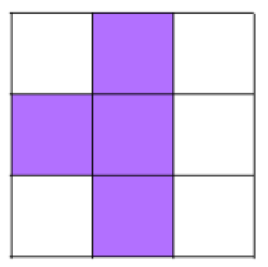
Level 3 - Symmetry
Can you make 3 different symmetrical shapes by colouring in squares?

Slide 5
Level 3 Question | How can you tell if a you have drawn a line of symmetry in the right place?
My answer / explanation.
My peer’s comment on my explanation.

Slide 6
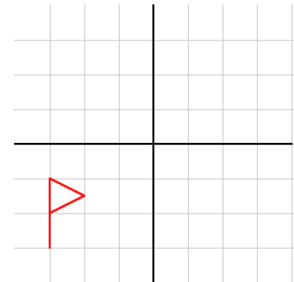
Level 4 - Reflections
Reflect the flag in each of the mirror line shown.
Mirror line
Mirror line

Slide 7
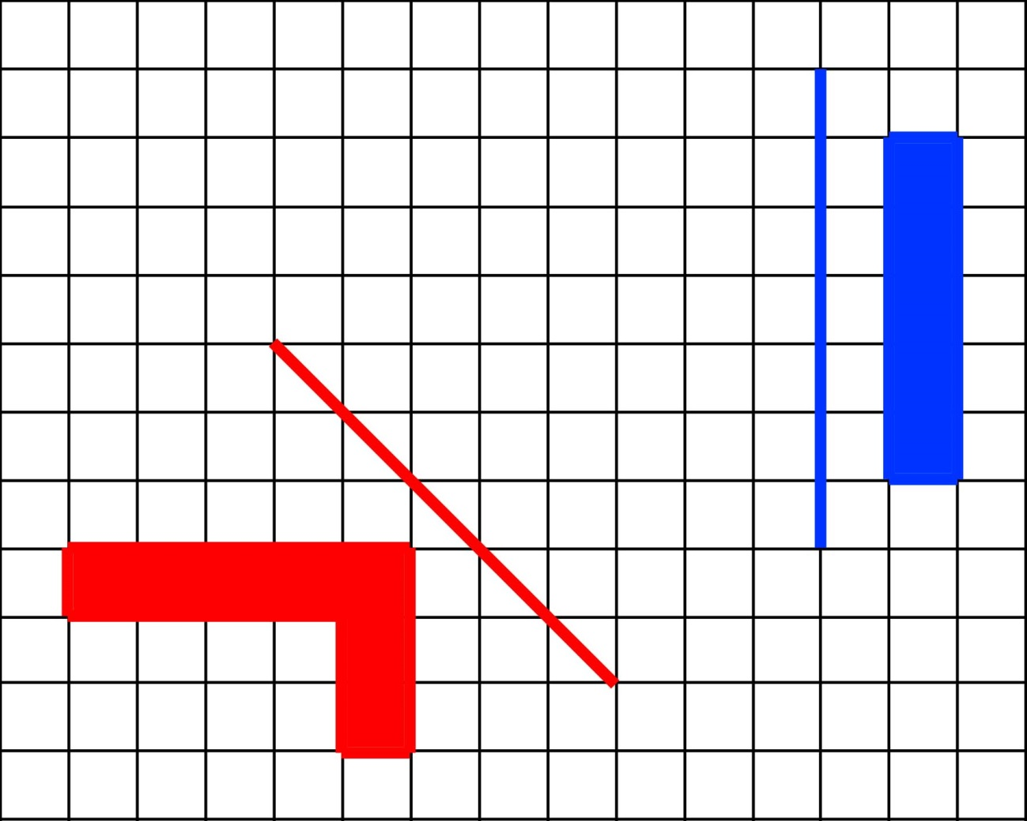
Level 4 - Reflections
Reflect each shape in the mirror line nearest to the shape.
What letter do your reflections make?

Slide 8
Level 4 Question | What should you do to check that you have accurately reflected a shape?
My answer / explanation.
My peer’s comment on my explanation.

Slide 9
Level 5 - Rotations
Rotate this shape 90° clockwise from the vertex (corner) marked with a dot.

Slide 10
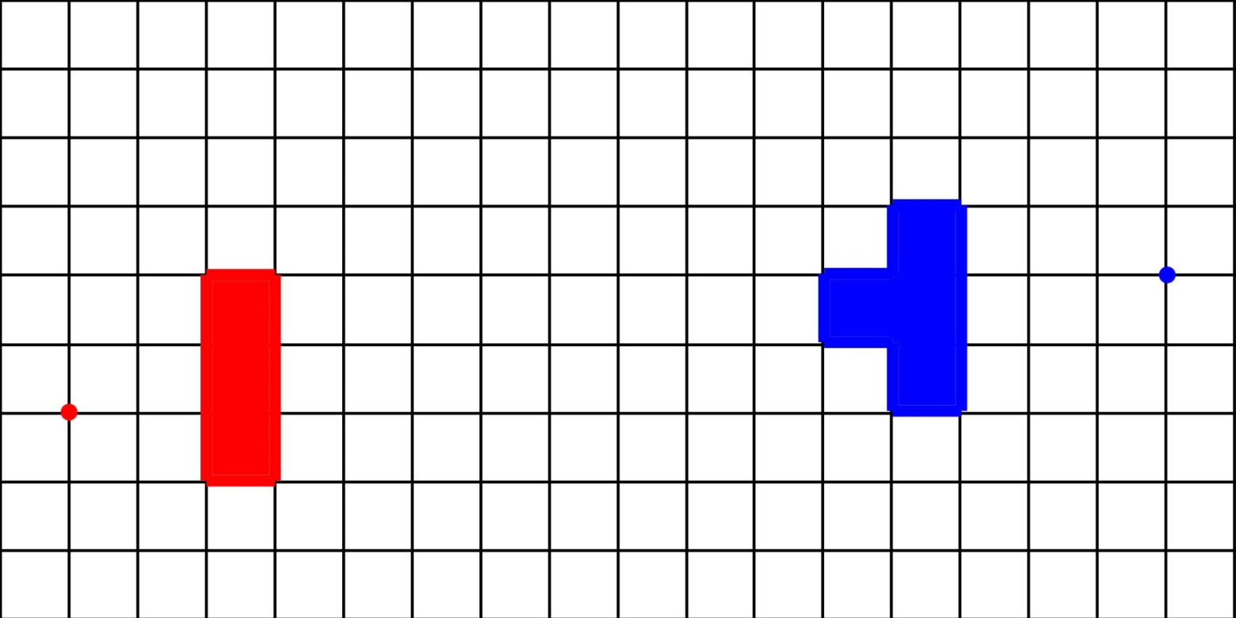
Level 5 - Enlargements
Enlarge these shapes from the centres of enlargements shown.
What letter do your enlargements makes?

Slide 11
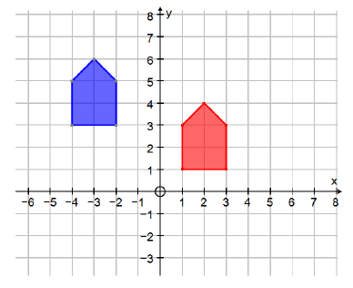
Level 5 - Translations
Q1) Translate shape A two squares right and 3 squares up $\left[\begin{aligned}2 \\ 3\end{aligned}\right]$
Label the image C.
Q2) Describe the translation which moves shape B to shape A.
B
A

Slide 12
Level 5 Question | What information would you need to give someone in order for them to rotate a shape accurately?
My answer / explanation.
My peer’s comment on my explanation.

Slide 13
Level 6 - Find the missing lengths
The second shape is an enlargement of the first shape.
What are the missing lengths?
What is the angle marked x?
6 cm
?cm
?
4 cm
90⁰
90⁰
?cm
4.5 cm
?
3 cm
5 cm
15cm
120⁰
x⁰
5 cm
?
? cm
12 cm

Slide 14
Level 6 - Combining transformations
When one transformation is followed by another, the resulting change can often be described by a single transformation.
Reflect shape A in the line y = x to give its image. Label the image B.
Then rotate B through 90° about the origin to give its image. Label the image C.
What single transformation will map shape A onto C?
y
y = x
A
x

Slide 15
Level 6 - Rotations
Rotate this shape 90⁰ clockwise using the centre of rotation (0,1)

Slide 16
Level 6 Question | Explain fully how you would find the centre of enlargement and the scale factor from the object and its image.
My answer / explanation.
My peer’s comment on my explanation.

Slide 17
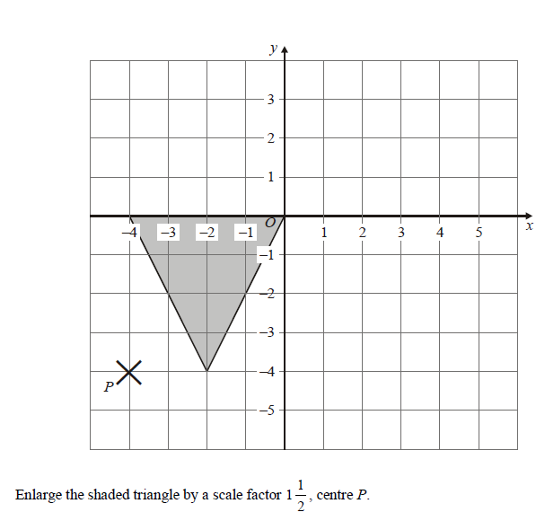
Level 7 - Enlargement

Slide 18
Level 7 Question | Explain fully how you worked out the size and position of the enlargement.
My answer / explanation.
My peer’s comment on my explanation.

Slide 19
Peer Assessment
Swap your assessment task.
You will need a copy of the purple assessment sheet so that you can tick the learning journey as we go through the answers.
Remember to check that the image your peer has drawn is accurate, how can you do this?
If in doubt, ask the teacher.

Slide 20
Level | 3 | 4 | 5 | 6 | 7
Transformations | I can reflect a shape in a horizontal or vertical line of symmetry. I can recognise when shapes are symmetrical and when they are not. | I can reflect a shape in a oblique (45⁰) mirror line. I am beginning to use the distance of vertices from the mirror line to reflect shapes more accurately | I can Reflect shapes in oblique (45°) mirror lines where the shape crosses the mirror line. I can reflect shapes not presented on grids, by measuring perpendicular distances to/from the mirror. I can enlarge a shape by positive scale factor from a centre of enlargement and I can find a centre of enlargement and a scale factor. I can rotate shapes, through 90° or 180°, when the centre of rotation is a vertex of the shape, and I can recognise these rotations. I can translate shapes. | I can find missing lengths and angles on diagrams that show an object and its image I can match corresponding lengths and angles of object and image shapes following reflection, translation and/or rotation or a combination of these. I can describe fully single transformations and combinations of transformations that will map one shape onto another shape. I can rotate shapes from a centre of rotation when the centre of rotation is not a vertex of the shape. I can recognise these rotations and find the centre of rotation. | I can enlarge a simple shape on squared paper by a fractional scale factor, such as ½ or 1/3 and recognise that the ratio of any two corresponding sides is equal to the scale factor.
Notes:
Print slides 19-20 two to a page on purple paper. When marking the assessment task the peer assessor should tick the skills achieved on the learning journey. (This slide.) The purple sheet should then be returned with the marked assessment to the pupil who completed the assessment so that they can add their self reflection. (Next slide.)

Slide 21
My own reflection on my learning in this unit of work. | To move my learning on I need to
To be a better learner I could……………….. | To move my learning on I need to improve my understanding of………………….
Notes:
Print slides 19-20 two to a page on purple paper. When marking the assessment task the peer assessor should tick the skills achieved on the learning journey. (Previous Slide.) The purple sheet should then be returned with the marked assessment to the pupil who completed the assessment so that they can add their self reflection to this slide.

Slide 22
Level 3 – Symmetry
Which of these shapes does not have line symmetry? Shape C
Which of these shapes has one line of symmetry? Draw it on the shape. Shape A
Which of these shapes has two lines of symmetry? Draw them on the shape. Shape B
Shape A
Shape B
Shape C

Slide 23
Level 3 - Symmetry
Can you make 3 different symmetrical shapes by colouring in squares?
Other suggestions
There may be other correct answers so put your hand up if you have something different to check.

Slide 24
Level 3 Question | How can you tell if a you have drawn a line of symmetry in the right place?
My answer / explanation. | If the shape is exactly the same each side of the mirror line… If the mirror line cuts the shape in half……
My peer’s comment on my explanation. | When writing your comment think about whether or not you understand their explanation and if not what they could have done differently to make it easier to understand.
Notes:
Make sure that pupils understand that there are other possible answers.

Slide 25
Level | 3 | 4 | 5 | 6 | 7
Transformations | I can reflect a shape in a horizontal or vertical line of symmetry. I can recognise when shapes are symmetrical and when they are not. √ | I can reflect a shape in a oblique (45⁰) mirror line. I am beginning to use the distance of vertices from the mirror line to reflect shapes more accurately | I can Reflect shapes in oblique (45°) mirror lines where the shape crosses the mirror line. I can reflect shapes not presented on grids, by measuring perpendicular distances to/from the mirror. I can enlarge a shape by positive scale factor from a centre of enlargement and I can find a centre of enlargement and a scale factor. I can rotate shapes, through 90° or 180°, when the centre of rotation is a vertex of the shape, and I can recognise these rotations. I can translate shapes. | I can find missing lengths and angles on diagrams that show an object and its image I can match corresponding lengths and angles of object and image shapes following reflection, translation and/or rotation or a combination of these. I can describe fully single transformations and combinations of transformations that will map one shape onto another shape. I can rotate shapes from a centre of rotation when the centre of rotation is not a vertex of the shape. I can recognise these rotations and find the centre of rotation. | I can enlarge a simple shape on squared paper by a fractional scale factor, such as ½ or 1/3 and recognise that the ratio of any two corresponding sides is equal to the scale factor.
If they have correctly answered the level 3 questions put a tick on the learning journey next to the level 3 description, as shown.

Slide 26
Level 4 - Reflections
Check that their images are the correct distance from the mirror lines..
Mirror line
Mirror line

Slide 27
Level 4 - Reflections
You get a U shape.
Check that it has been drawn in the correct place.

Slide 28
Level 4 Question | What should you do to check that you have accurately reflected a shape?
My answer / explanation. | Check that it is the same distance from the mirror line as the object…. Check that it is facing the opposite way to the object…. Use tracing paper or a mirror ………
My peer’s comment on my explanation. | When writing your comment think about whether or not you understand their explanation and if not what they could have done differently to make it easier to understand.

Slide 29
Level | 3 | 4 | 5 | 6 | 7
Transformations | I can reflect a shape in a horizontal or vertical line of symmetry. I can recognise when shapes are symmetrical and when they are not. | I can reflect a shape in a oblique (45⁰) mirror line. √ I am beginning to use the distance of vertices from the mirror line to reflect shapes more accurately √ | I can Reflect shapes in oblique (45°) mirror lines where the shape crosses the mirror line. I can reflect shapes not presented on grids, by measuring perpendicular distances to/from the mirror. I can enlarge a shape by positive scale factor from a centre of enlargement and I can find a centre of enlargement and a scale factor. I can rotate shapes, through 90° or 180°, when the centre of rotation is a vertex of the shape, and I can recognise these rotations. I can translate shapes. | I can find missing lengths and angles on diagrams that show an object and its image I can match corresponding lengths and angles of object and image shapes following reflection, translation and/or rotation or a combination of these. I can describe fully single transformations and combinations of transformations that will map one shape onto another shape. I can rotate shapes from a centre of rotation when the centre of rotation is not a vertex of the shape. I can recognise these rotations and find the centre of rotation. | I can enlarge a simple shape on squared paper by a fractional scale factor, such as ½ or 1/3 and recognise that the ratio of any two corresponding sides is equal to the scale factor.
If they have correctly answered the level 4 questions put a tick on the learning journey next to the level 4 description, as shown.

Slide 30
Level 5 - Rotations

Slide 31
Level 5 - Enlargements
You get a H shape.
Check that it has been drawn in the correct place.

Slide 32
Level 5 - Translations
Q1) Translate shape A two squares right and 3 squares up $\left[\begin{aligned}2 \\ 3\end{aligned}\right]$
Label the image C.
Q2) Describe the translation which moves shape B to shape A.
5 Squares right and two squares down. $\left[\begin{aligned}5 \\ −2\end{aligned}\right]$
C
B
A

Slide 33
Level 5 Question | What information would you need to give someone in order for them to rotate a shape accurately?
My answer / explanation. | You would have to tell them the direction, the degrees and the centre of rotation…
My peer’s comment on my explanation. | When writing your comment think about whether or not you understand their explanation and if not what they could have done differently to make it easier to understand.

Slide 34
Level | 3 | 4 | 5 | 6 | 7
Transformations | I can reflect a shape in a horizontal or vertical line of symmetry. I can recognise when shapes are symmetrical and when they are not. | I can reflect a shape in a oblique (45⁰) mirror line. I am beginning to use the distance of vertices from the mirror line to reflect shapes more accurately | I can Reflect shapes in oblique (45°) mirror lines where the shape crosses the mirror line. I can reflect shapes not presented on grids, by measuring perpendicular distances to/from the mirror. I can enlarge a shape by positive scale factor from a centre of enlargement and I can find a centre of enlargement and a scale factor. √ I can rotate shapes, through 90° or 180°, when the centre of rotation is a vertex of the shape, and I can recognise these rotations. I can translate shapes. √ | I can find missing lengths and angles on diagrams that show an object and its image I can match corresponding lengths and angles of object and image shapes following reflection, translation and/or rotation or a combination of these. I can describe fully single transformations and combinations of transformations that will map one shape onto another shape. I can rotate shapes from a centre of rotation when the centre of rotation is not a vertex of the shape. I can recognise these rotations and find the centre of rotation. | I can enlarge a simple shape on squared paper by a fractional scale factor, such as ½ or 1/3 and recognise that the ratio of any two corresponding sides is equal to the scale factor.
√
If they have correctly answered the level 5 questions put a tick on the learning journey next to the level 4 descriptions, as shown.

Slide 35
Level 6 - Find the missing lengths
The second shape is an enlargement of the first shape.
What are the missing lengths?
What is the angle marked x?
6 cm
2cm
?
4 cm
90⁰
90⁰
9cm
4.5 cm
?
3 cm
5 cm
15cm
120⁰
60⁰
5 cm
?
4cm
12 cm

Slide 36
Level 6 - Combining transformations
When one transformation is followed by another, the resulting change can often be described by a single transformation.
Reflect shape A in the line y = x to give its image. Label the image B.
y
y = x
Then rotate B through 90° about the origin to give its image. Label the image C.
A
C
What single transformation will map shape A onto C?
x
B
We can map shape A onto shape C by a reflection in the y-axis.

Slide 37
Level 6 - Rotations

Slide 38
Level 6 Question | Explain fully how you would find the centre of enlargement and the scale factor from the object and its image.
My answer / explanation. | To find the scale factor work out how many times bigger or smaller the length or height of the image is compared to the object. To find the centre of enlargement draw lines connecting each vertex on the image to the corresponding vertex on the object. Where these lines cross is the centre of enlargement.
My peer’s comment on my explanation. | When writing your comment think about whether or not you understand their explanation and if not what they could have done differently to make it easier to understand.

Slide 39
Level | 3 | 4 | 5 | 6 | 7
Transformations | I can reflect a shape in a horizontal or vertical line of symmetry. I can recognise when shapes are symmetrical and when they are not. | I can reflect a shape in a oblique (45⁰) mirror line. I am beginning to use the distance of vertices from the mirror line to reflect shapes more accurately | I can Reflect shapes in oblique (45°) mirror lines where the shape crosses the mirror line. I can reflect shapes not presented on grids, by measuring perpendicular distances to/from the mirror. I can enlarge a shape by positive scale factor from a centre of enlargement and I can find a centre of enlargement and a scale factor. I can rotate shapes, through 90° or 180°, when the centre of rotation is a vertex of the shape, and I can recognise these rotations. I can translate shapes. | I can find missing lengths and angles on diagrams that show an object and its image I can match corresponding lengths and angles of object and image shapes following reflection, translation and/or rotation or a combination of these. I can describe fully single transformations and combinations of transformations that will map one shape onto another shape. I can rotate shapes from a centre of rotation when the centre of rotation is not a vertex of the shape. I can recognise these rotations and find the centre of rotation. | I can enlarge a simple shape on squared paper by a fractional scale factor, such as ½ or 1/3 and recognise that the ratio of any two corresponding sides is equal to the scale factor.
√
√
√
If they have correctly answered the level 6 questions put a tick on the learning journey next to the level 6 descriptions, as shown.

Slide 40
Vertices of new triangle at (–1, –4) (–4, 2) and (2, 2)

Slide 41
Level 7 Question | Explain fully how you worked out the size and position of the enlargement.
My answer / explanation. | I multiplied the length of each side by 1.5 to work out the size of the image. I worked out how far away from the centre of enlargement each vertex of the object was and multiplied this by 1.5 to work out how far away from the centre of enlargement the vertices of the image should be.
My peer’s comment on my explanation. | When writing your comment think about whether or not you understand their explanation and if not what they could have done differently to make it easier to understand.

Slide 42
Level | 3 | 4 | 5 | 6 | 7
Transformations | I can reflect a shape in a horizontal or vertical line of symmetry. I can recognise when shapes are symmetrical and when they are not. | I can reflect a shape in a oblique (45⁰) mirror line. I am beginning to use the distance of vertices from the mirror line to reflect shapes more accurately | I can Reflect shapes in oblique (45°) mirror lines where the shape crosses the mirror line. I can reflect shapes not presented on grids, by measuring perpendicular distances to/from the mirror. I can enlarge a shape by positive scale factor from a centre of enlargement and I can find a centre of enlargement and a scale factor. I can rotate shapes, through 90° or 180°, when the centre of rotation is a vertex of the shape, and I can recognise these rotations. I can translate shapes. | I can find missing lengths and angles on diagrams that show an object and its image I can match corresponding lengths and angles of object and image shapes following reflection, translation and/or rotation or a combination of these. I can describe fully single transformations and combinations of transformations that will map one shape onto another shape. I can rotate shapes from a centre of rotation when the centre of rotation is not a vertex of the shape. I can recognise these rotations and find the centre of rotation. | I can enlarge a simple shape on squared paper by a fractional scale factor, such as ½ or 1/3 and recognise that the ratio of any two corresponding sides is equal to the scale factor.
√
If they have correctly answered the level 7 questions put a tick on the learning journey next to the level 6 descriptions, as shown. Return the purple sheet and the assessment task to the pupil whose assessment it is.

Slide 43
Self Assessment
Collect back your assessment task and the purple sheet.
Have a look at your learning journey. Your peer has ticked the skills that you have demonstrated in this assessment.
Pick an un-ticked skill as your target and write EBI next to it.
Complete the self assessment boxes on the purple sheet.

